Slide 1








INTELLIGENT MECHATRONICS PROJECT PRESENTATION
SMART IRRIGATION SYSTEM

Slide 2


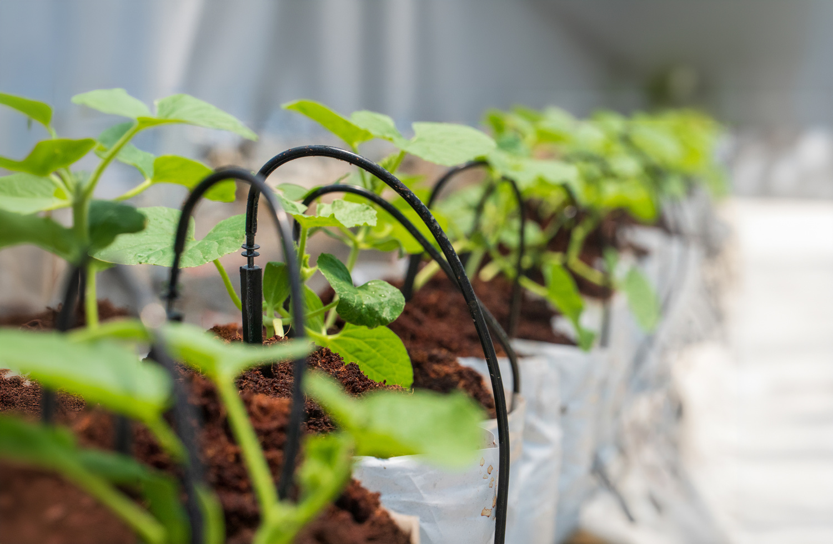
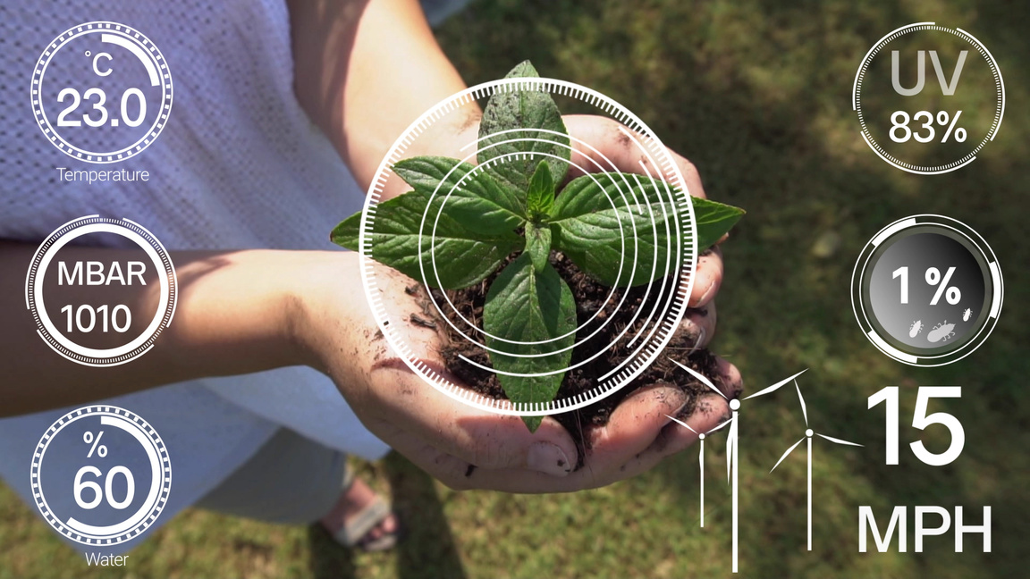
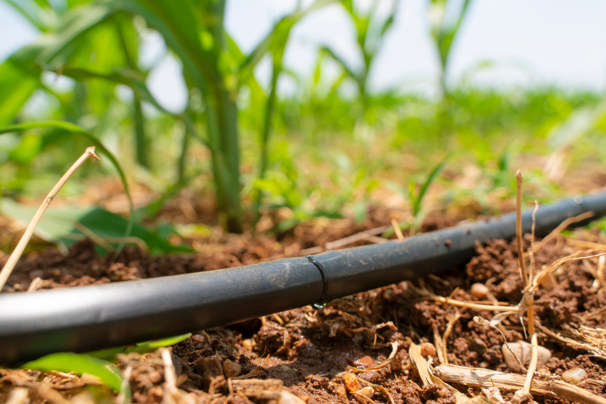


PROJECT OVERVIEW
01
02
03
AUTONOMOUS IRRIGATION SYSTEM
USES REAL-TIME SENSOR AND WEATHer data
REDUCES WATER WASTE AND MANUAL INTERVENTION
SMART IRRIGATION SETUP
ENVIRONMENTAL SENSING
EFFICIENT WATER USE

Slide 3


OBJECTIVES & MOTIVATION
MAIN POINTS
Develop a cost-effective and intelligent irrigation solution.
Reduce manual labor and human dependency in watering systems.
Prevent unnecessary water usage by making real-time decisions.
Integrate sensor feedback and online weather data for optimized control.
Apply rule-based decision logic to simulate basic AI behavior.
Align with the course goal of building context-aware mechatronic systems.
OPTIONAL VISUALS
A water droplet icon (representing resource conservation)
A thinking gear icon (for intelligence)
A hand replaced by a robot watering (to show automation)

Slide 4

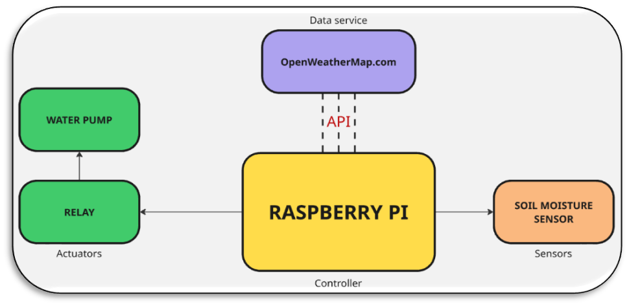
SYSTEM ARCHITECTURE
This system combines hardware components and cloud data to form a responsive and autonomous irrigation solution. It follows a sensor–controller–actuator architecture integrated with an external data service.
MAIN POINTS
The system is built around a Raspberry Pi acting as the main controller.
A soil moisture sensor provides real-time environmental feedback.
Weather information is retrieved from OpenWeatherMap API using HTTP requests.
A relay module controls the activation of a water pump based on decision logic.
All components work together to create an autonomous, adaptive irrigation process.

Slide 5


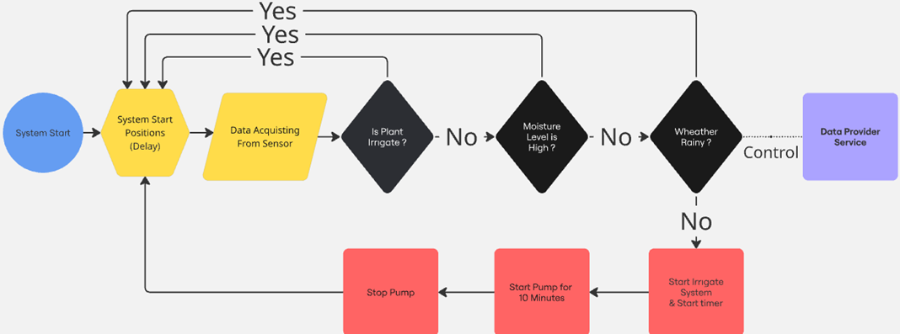

OPERATION FLOW
The system continuously monitors sensor data and weather conditions, making real-time decisions through a rule-based algorithm. The flow ensures that water is only used when necessary.
MAIN STEPS
System starts and initializes all components.
Sensor data is collected to evaluate soil moisture.
The system checks:
* Is irrigation needed?
*Is the moisture level sufficient?
*Is it raining? (based on API)
4.If all conditions are appropriate →
* Start pump for 10 minutes
5.If any condition is not met →
* Pump remains off or system waits.
6.The loop continues autonomously every 10 minutes.

Slide 6


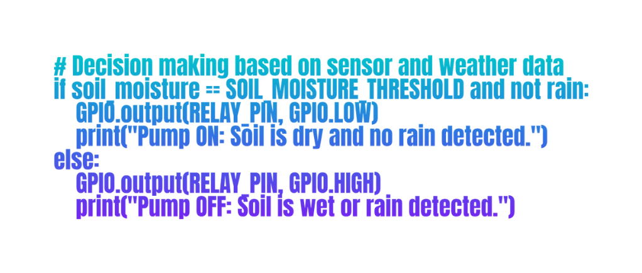

PYTHON CODE OVERVIEW
The system is programmed using Python on a Raspberry Pi. It integrates GPIO-based sensor control and HTTP requests to fetch weather data, enabling intelligent irrigation decisions.
KEY CODE FEATURES
Written in Python 3, executed on Raspberry Pi OS
Uses RPi.GPIO to read soil moisture sensor input
Uses requests library to access OpenWeatherMap API
Makes decisions via if-else logic based on:
Sensor status (dry/wet)
Weather data (rain/no rain)
Controls relay output to activate or stop water pump
Runs in an infinite loop with 10-minute intervals

Slide 7

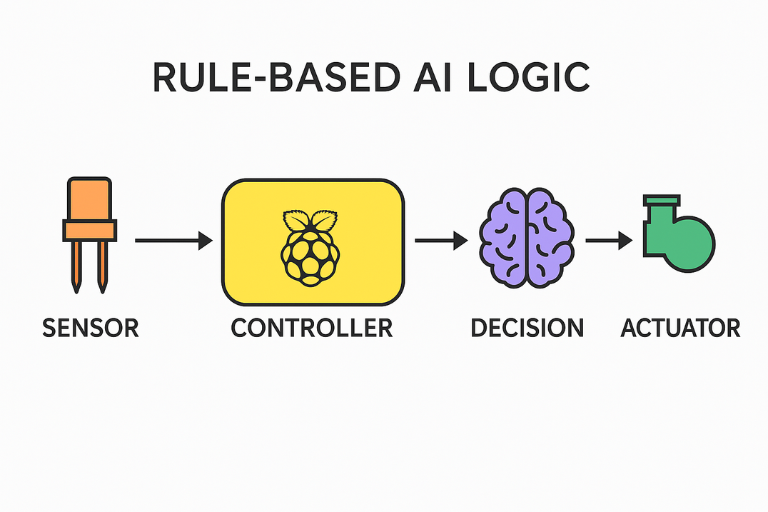
INTELLIGENT SYSTEM FEATURES
Although this system does not use machine learning, it demonstrates intelligent behavior through real-time data analysis and rule-based decision-making. It qualifies as a basic autonomous, context-aware mechatronic system.
MAIN POINTS
Integrates real-time sensor data with external weather conditions
Makes autonomous decisions without human intervention
Uses if-else decision logic to evaluate environmental context
Controls hardware (relay & pump) dynamically based on system inputs
Demonstrates key characteristics of intelligent systems:
Reactivity (responds to changes)
Autonomy (acts independently)
Context-awareness (understands environment)

Slide 8


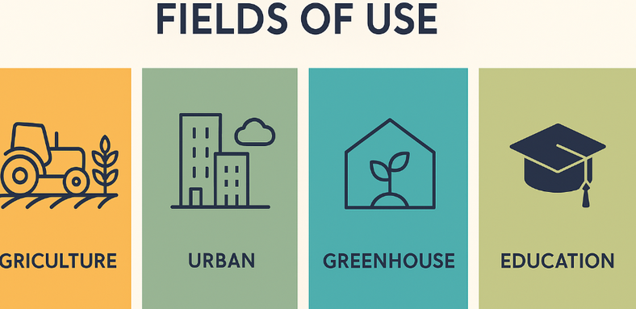
APPLICATION AREAS
The Smart Irrigation System is designed for diverse applications where intelligent water management is crucial. Its flexible architecture allows seamless integration into various environments.
MAIN APPLICATION AREAS
Smart Agriculture
Greenhouse Automation
Enhances water efficiency in large-scale farming
Reduces human intervention and labor costs
Adapts to different soil and crop types
Maintains optimal soil moisture for high-yield plant growth
Automatically adjusts irrigation based on environmental data
Prevents waterlogging and nutrient loss
Urban Farming in Smart Cities
Educational AI & Mechatronics Platforms
Supports green infrastructure in urban environments
Enables precision irrigation for rooftop gardens and community farms
Contributes to sustainable city planning
Serves as a practical example for IoT and smart agriculture courses
Demonstrates sensor integration and real-time decision making
Perfect for research and academic projects

Slide 9

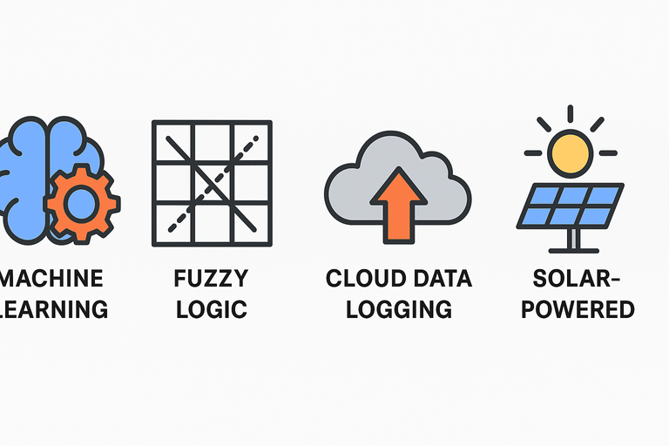


RESULTS & FUTURE ENHANCEMENTS
The Smart Irrigation System successfully achieved its primary goals of autonomous irrigation and real-time decision-making. Future improvements can further enhance its intelligence and efficiency.
01
Real-time monitoring of soil moisture and weather conditions
Autonomous control of water pump based on decision logic
Effective water management with minimal human intervention
Optimized for both small-scale and large-scale agriculture
Results
Machine Learning Integration
Train models on historical weather and soil data
Predict irrigation needs more accurately
Fuzzy Logic Implementation
Handle uncertain sensor readings
Improve decision robustness in variable conditions
Cloud Data Logging
Store historical sensor data for long-term analysis
Improve predictive maintenance and efficiency
Solar-Powered System
Enhance sustainability with renewable energy
Reduce operational costs and environmental impact
02
Future Enhancements

Slide 10

REFERENCES
The following references were used to design and implement the Smart Irrigation System, covering topics such as sensor integration, real-time weather data, and intelligent decision-making.
MAIN REFERENCES
Raspberry Pi GPIO Documentation
Smart Agriculture Research Papers
Official documentation for GPIO pin control on Raspberry Pi
https://www.raspberrypi.com/documentation/
A Novel Autonomous Irrigation System for Smart Agriculture
https://www.sciencedirect.com/science/article/abs/pii/S0141933123001497
OpenWeatherMap API Documentation
Integrating Artificial Intelligence into Automated Irrigation Systems
Comprehensive guide for accessing real-time weather data
https://openweathermap.org/api
A Novel Autonomous Irrigation System for Smart Agriculture
https://www.mdpi.com/1424-8220/25/4/1199
IoT-Based Smart Farming Solutions
Applications of IoT in precision agriculture
https://www.researchgate.net/publication/367392753_Smart_Irrigation_Systems_in_Agriculture_A_Systematic_Review

Slide 11
ACKNOWLEDGMENTS & CONCLUSION
Acknowledgments
I would like to express my gratitude to:
[Supervisor's Name] for providing valuable guidance and support throughout the project.
Conclusion
The Smart Irrigation System successfully demonstrated:
Autonomous decision-making
Efficient water management
Real-time adaptation to environmental changes
Future enhancements such as Machine Learning and Cloud Integration can elevate its intelligence.
This project showcases the potential of mechatronics and AI in sustainable agriculture.

Slide 12

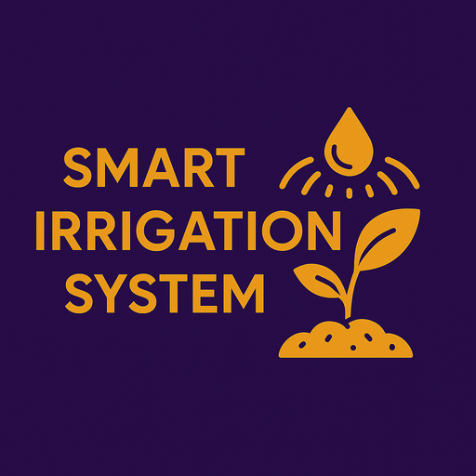
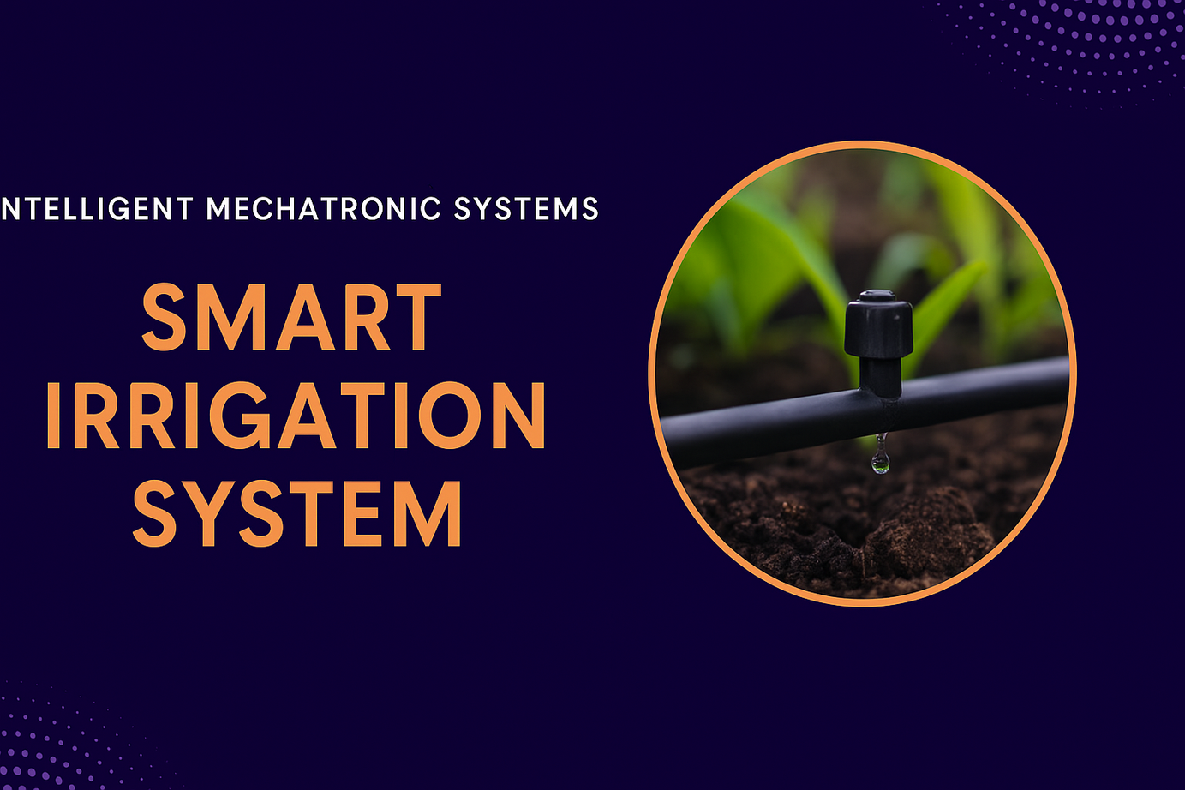

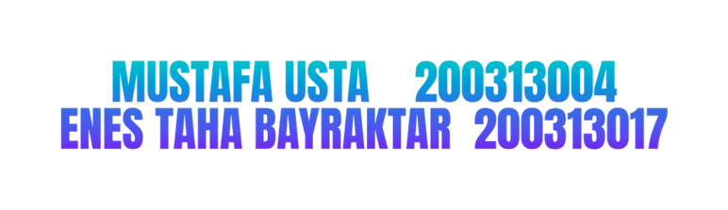

THANKS FOR LISTENING

